Slide 1
Technology in America
Professor Meyer

Slide 2
Listening Exercises
Unit 10, p. 114-115, #1-4
  Outside View

Slide 3
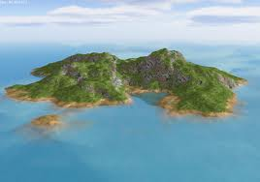
Survivor
You are stranded on an island, but for some magical reason, you can choose any 3 things to help you survive.
  Share with your team your best survival skill.
  As a team, choose 3 things to have on the island to help you survive.
  Share with the class, the 3 items your team chose and why those items make you more capable of surviving.
Only use English!

Slide 4
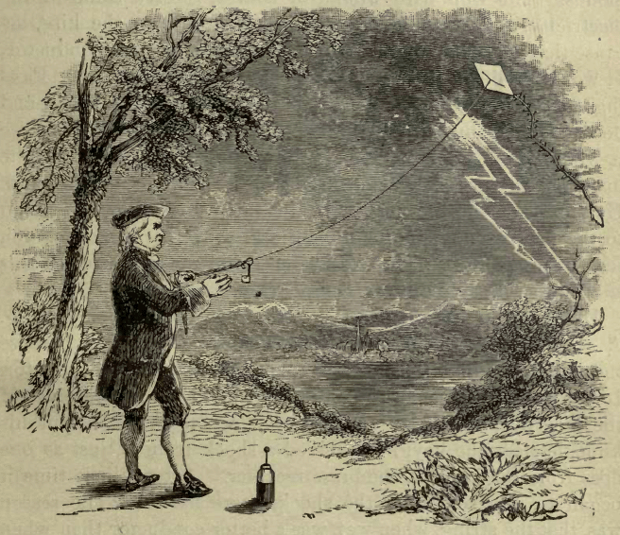
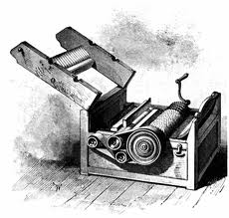
Early American Technology
Ben Franklin: 1706-1790
  Electricity; invented the lightning rod
Eli Whitney: 1765-1825
  Invented the cotton gin
  Revolutionized cotton
  industry

Slide 5
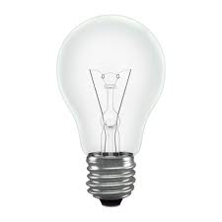
Industrial Revolution: 1870-1914
Nikola Tesla: 1856-1943
  Alternating current (AC) motor, light bulbs, x-rays, Tesla coil, radio, remote control, robotic, lasers, wireless communications
Thomas Edison: 1847-1931
  Stole inventions from Tesla
  Menlo Park Labs
Henry Ford: 1863-1947
  Assembly line enabled mass production

Slide 6
Computer Revolution
Internet: 1950s-current
  Originated in American universities
  Internet censorship in China
  Internet=knowledge; knowledge=power
Personal computing: 1970s
  Made popular due to innovation from entrepreneurs like Bill Gates and Steve Jobs
Google: 1990s
  Indexing the internet
Apple: 2000-current
  iPhone and iPad apps
Notes:
entrepreneur |ˌäntrəprəˈno͝or, -ˈnər|nouna person who organizes and operates a business or businesses, taking on greater than normal financial risks in order to do so.

Slide 7
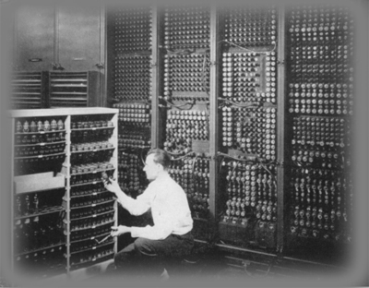

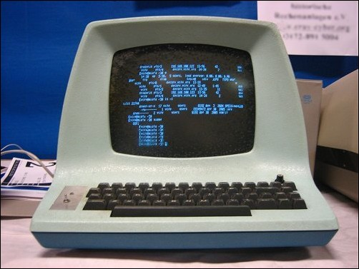
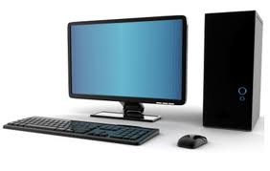
What do you think was the greatest invention?
Why?

Slide 8
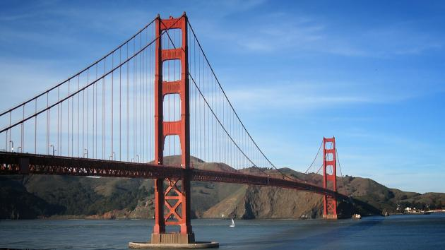
Future of Technology
Start up culture
  San Francisco: start up hub
  Reflect American individualism
What’s next?
  Smart Things
  Biotechnology
Notes:
start-up |ˈstɑr ˌdəp|(also startup |ˈstärtˌəp|)nounthe action or process of setting something in motion: the start-up of marketing in Europe | [ as modifier ] : start-up costs.• a newly established business: problems facing start-ups and small firms in rural areas.
biotechnology |ˌbīōtekˈnäləjē|nounthe exploitation of biological processes for industrial and other purposes, esp. the genetic manipulation of microorganisms for the production of antibiotics, hormones, etc.

Slide 9


Slide 10
Speaking Activity
If you could start a startup, what would you do?
  Think of a great business idea for your startup.
  Share it with your classmates.
  Try to convince people that your idea will be the best and most profitable business.
  Gather “investors” and stay together in a group.
  Try to form the biggest group.

Slide 11
Homework
Unit 10, p. 116-117, #1-3

Slide 12
Quiz 2
What is wrong with Janet’s computer?
  Out of power
  Screen is cracked
  Graphics card is bad
  It is has no memory
What is NOT true about Kate’s book?
  She is reading Alice in Wonderland.
  It is a 19th century children’s story.
  It takes place in Oxford, England.
  The author of the book is Mark Twain.
Extra Credit: Describe one of the science project from the article STEM: Making a Difference.
Notes:
Inside View: Conversation 1

